Slide 1

Rajneesh Hajela
Microservices & Azure Overview

Slide 2
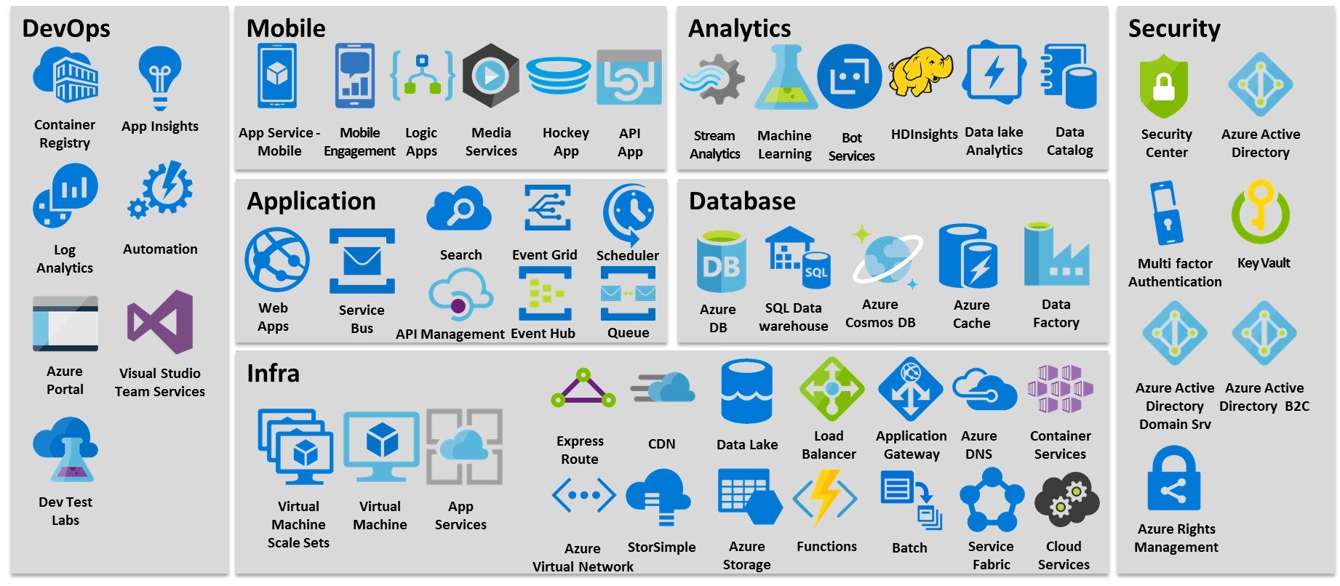
Azure Services

Slide 3
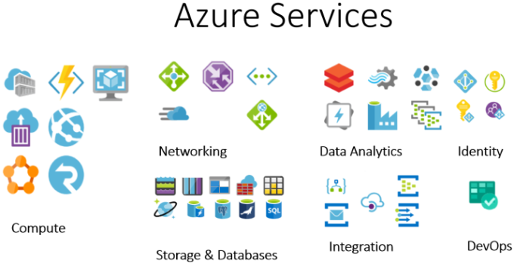

Slide 4
Azure Services
Azure Storage: Blob, File, Table, Queue, Disk (Tool: Azure store Explorer), Azure DataLake Storage
Azure App Services, Deployment Slot
Azure SQL database. VM with SQL DB, Azure SQl DB Management Instance (Backup, Recovery Service vault), RTO, RPO
Azure CosmosDB (NO SQL DB)
Azure Function: Function chaining, Fan-out/fan-in, Async HTTP APIs, Monitoring, Human interaction, Aggregator (stateful entities)
Identity & Access Management (User, Role, Group), Entra ID, APIM, Key Vault, Certificate, AD Connect
Azure Compute VM, VMSS (Linux, Windows)
Azure Event Grid, Event hub, Service Bus
Azure Logic App
Azure Data Factory, Data lake storage
Azure application Gateway, Azure traffic manager, Azure front door(Global), Azure load balancer(Global)
Monitor, Policy, blueprint –Azure Policy, Azure Blueprint, Azure Monitor, Azure application insight, Azure log Analytics
Deployment: Azure DevOps CICD Pipeline, AKS (Docker, Kubernetes)
Backup & Disaster Recovery: Azure Backup, Azure Site Recovery, DNS, CDN, (VM Backup, SQL Server backup)
Azure Networking (VPN, Subnet, NSG, ASG)
ARM Template & Azure Bicep
Zero Downtime : Deploy on Dev, stage, Prod environment (Blue green Deployment)

Slide 5
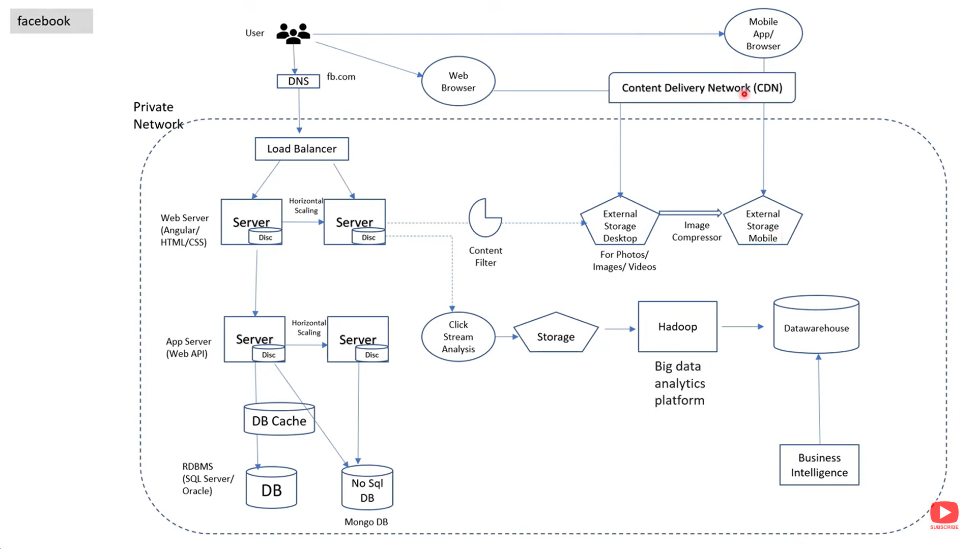

Slide 6
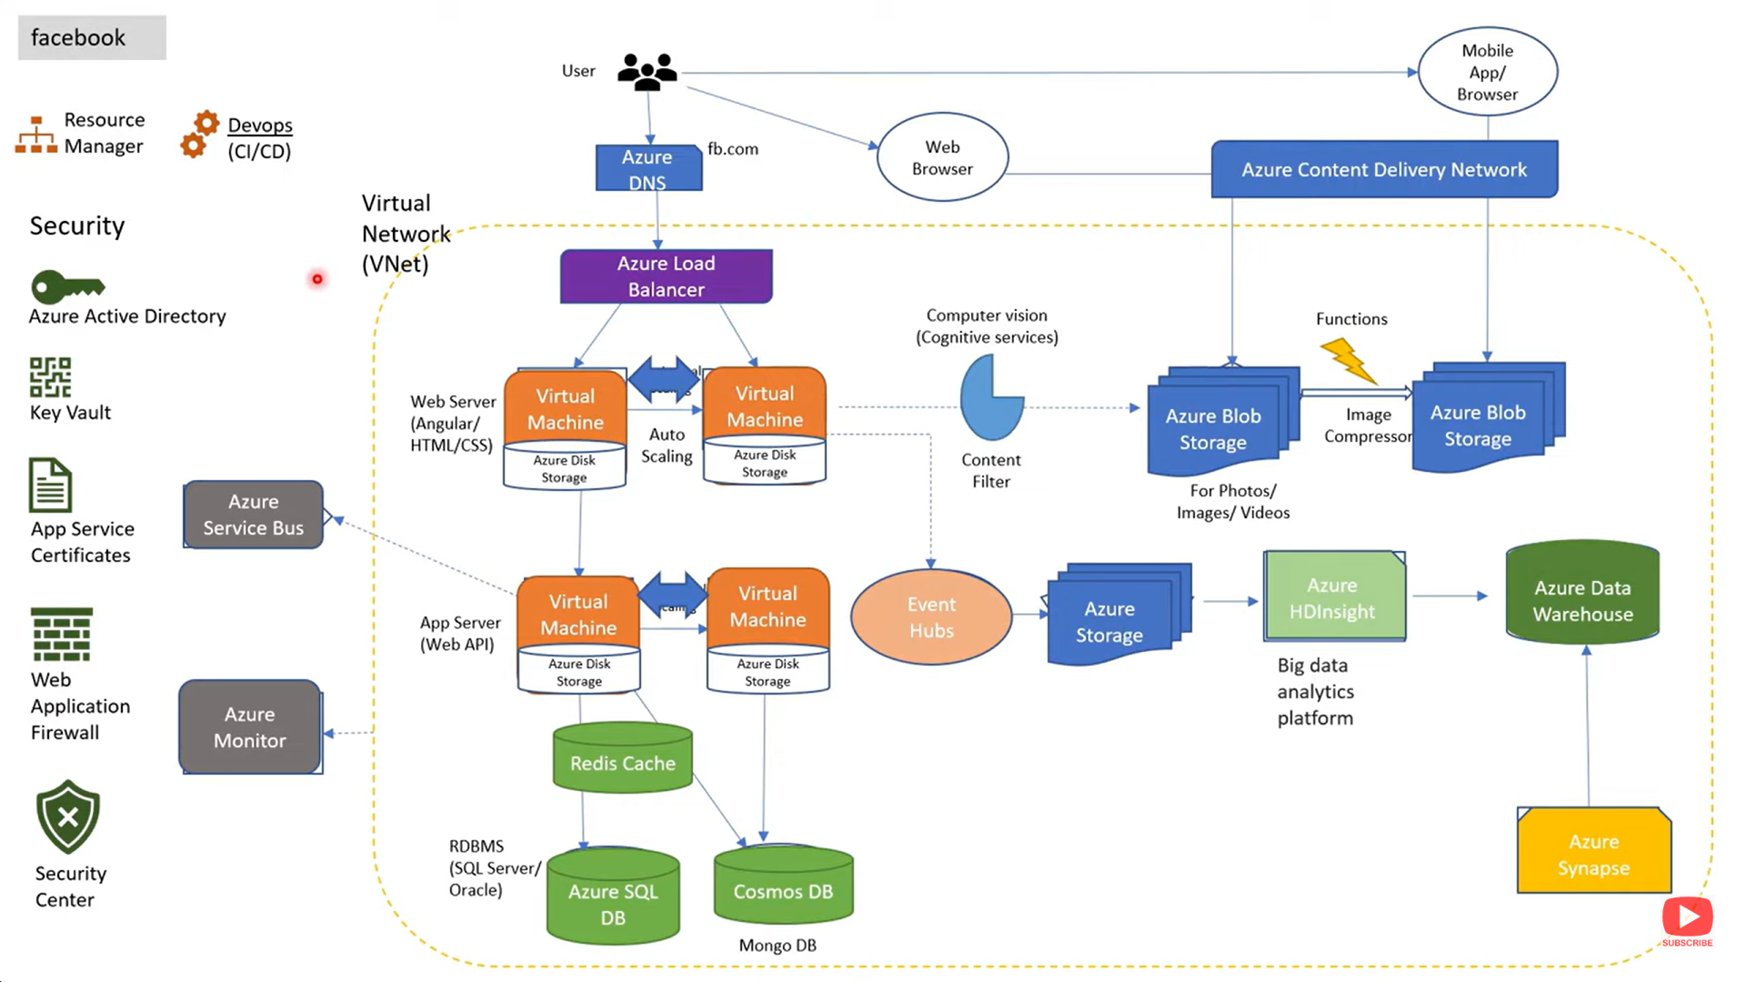

Slide 7
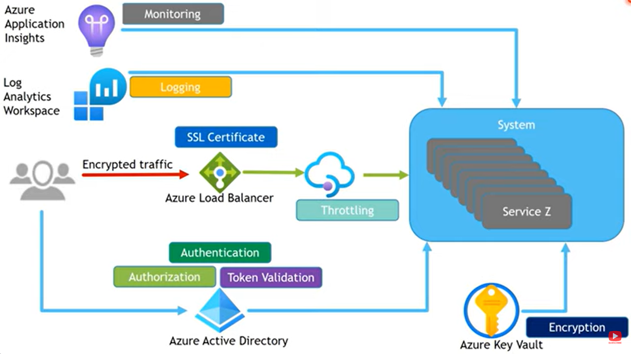
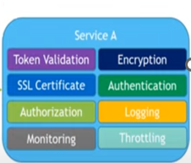
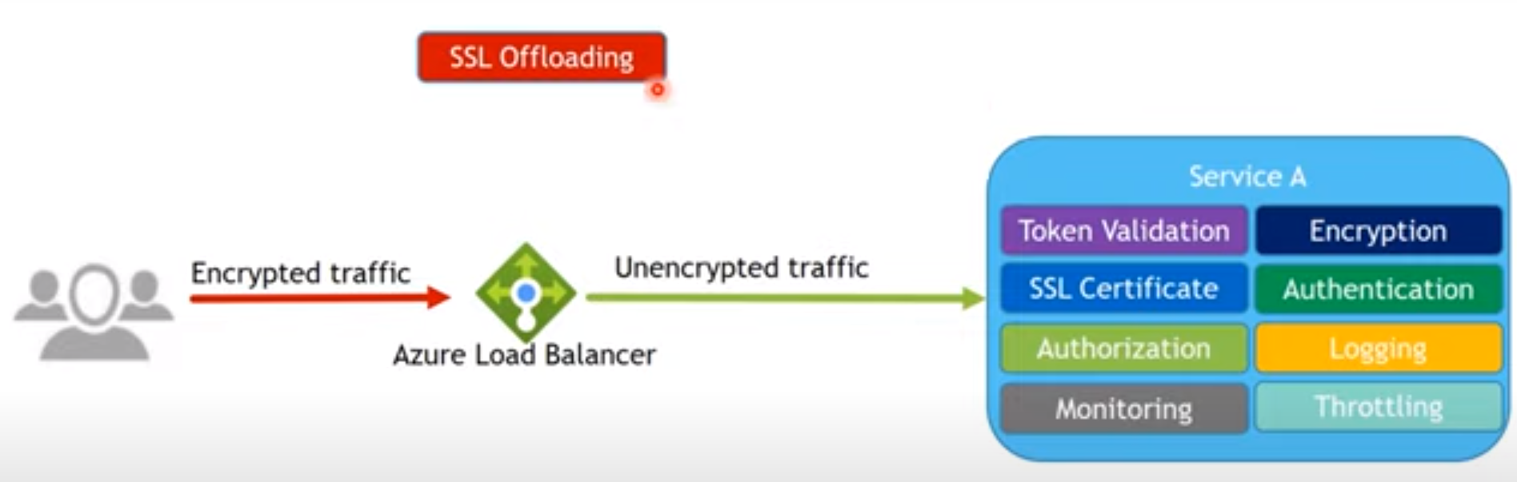
API Services(Get, Post, Put, Patch, Delete)

Slide 8
OnPremise Architecture
VS
Azure Services Overview

Slide 9
On-Premise Architecture
Deployment – VM- IIS and Db on SQL Server DataBase
Security- Authentication & Authorization (User, Role, Group) – application-level security, SQL Server Security, Storage security
Logging – Server log, event log, Splunk
Storage – Images, Files, Docs, pdf and other files.(Stored in VM)
Backup & DR – RTO, RPO, Downtime 2-3 hour (Application Backup, DB Backup)
Heavy Load at occasion
Caching – Output, Data, Fragment, Donut, In memory
Health check - Infra team – Monitoring each server, Backup, restore
--------------------------------------------
Auto Load Balancer on multiple region, Zones
Zero Downtime Deployment,
Major Security breach issue.
Architecture require for heavy load (When load high and low)
Virtual Machine
(CPU, Memory, storage)
(IIS)-.NET
SQL Server DB

Slide 10
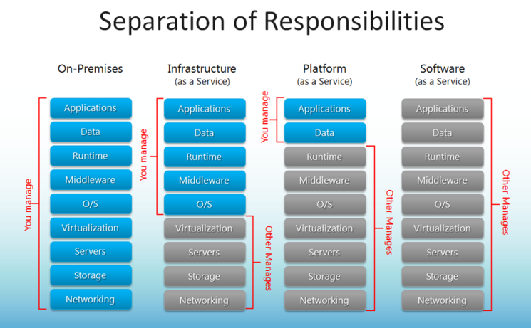

Slide 11
Let’s Deploy on Azure Cloud Environment
Deployment – VM- IIS
Authentication & Authorization (User, Role, Group)
Logging
Monitoring
Security
Storage
Backup & DR
Heavy Load at occasion
Caching – Output, Data, Fragment, Donut, In memory
Health check - Infra team – Monitoring each server
--------------------------------------------
Auto Load Balancer, Zero Downtime Deployment, Serverless architecture
Virtual Machine
(CPU, Memory, storage)
(IIS)-.NET
SQL Server DB
Application deployment – Azure app services
Data Base- Azure SQL DB
Security-Authentication & Authorization (User, Role, Group) – Azure AD, APIM (If using multiple APIs), Azure Security, Azure Key Vault (Certificate)
Logging & Monitoring – Azure application Insight, monitor, Log Analytics
Storage – Azure Storage(BLOB, FILE, TABLE, QUEUE, DISK), Azure Data Lake Storage (ADLS)
Backup & DR – VM Backup, SQL Server Backup, Azure Site recovery, Availability set, Availability Zone, Multiple region
Heavy Load Auto Load Balancer (Azure Traffic Manager/ load balancer/ application gateway/ Front door)
Caching – Azure Cache for Redis , CDN
Automation : Azure logic app, Azure Batch job, Azure Function( Orchestration and event trigger, Binding etc)
Zero Downtime- Blue Green Deployment (Azure DevOps CICD Pipeline, Azure Repo, Containerization(Docker Image) & Orchestration( Azure AKS

Slide 12
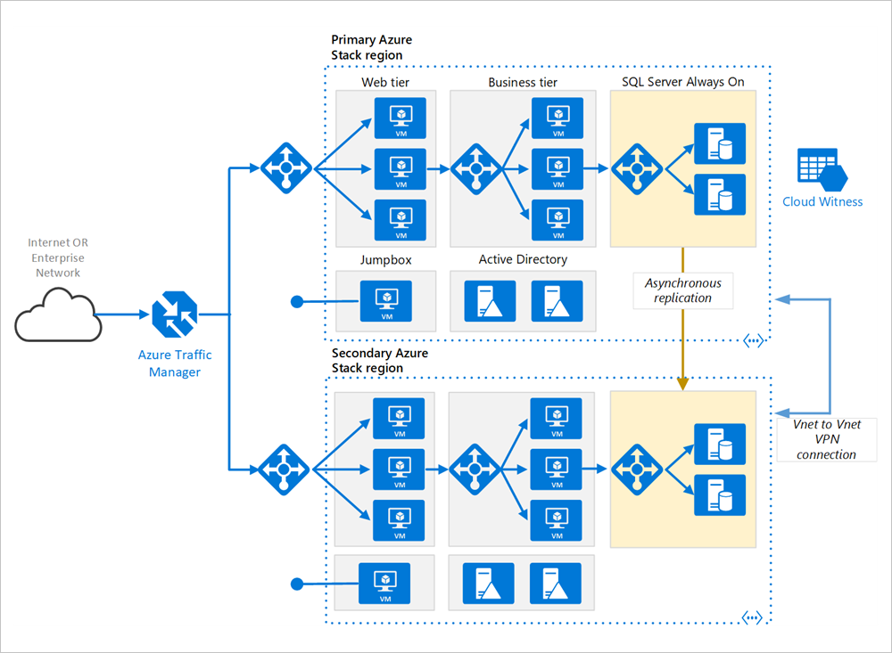
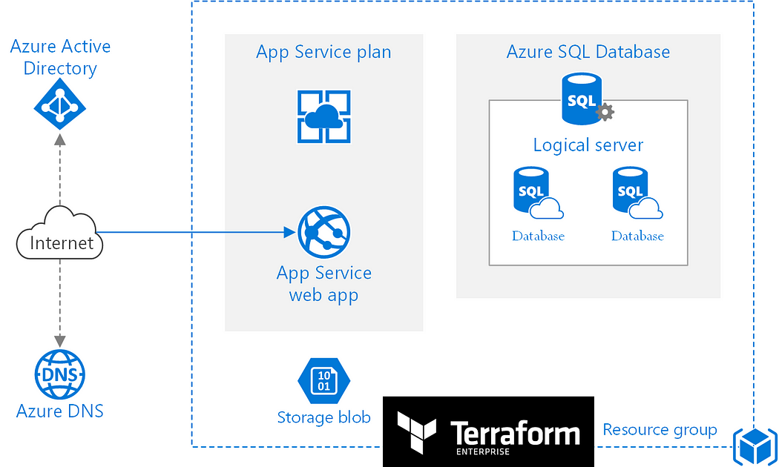
IAAS Architecture
PAAS ARchitecture

Slide 13
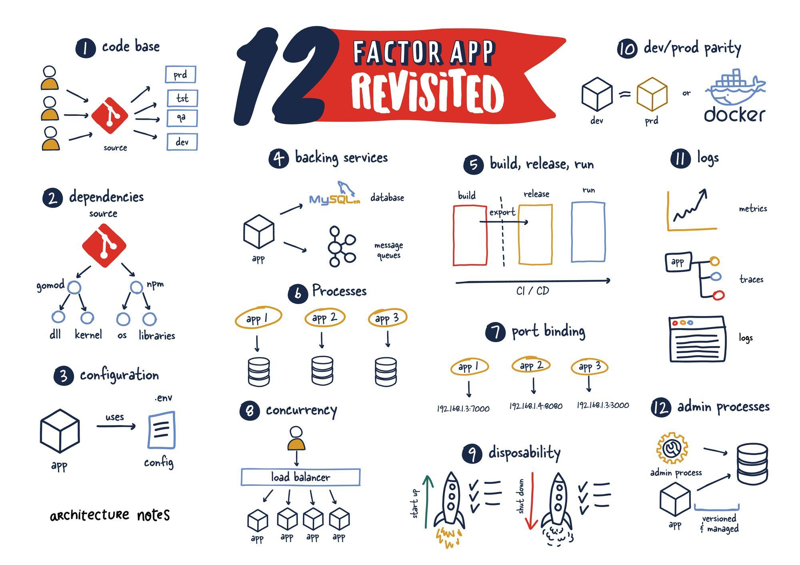

Slide 14
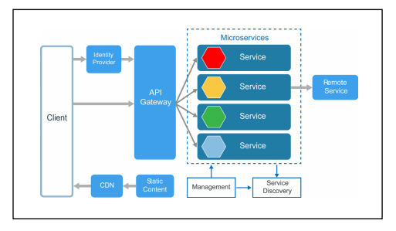
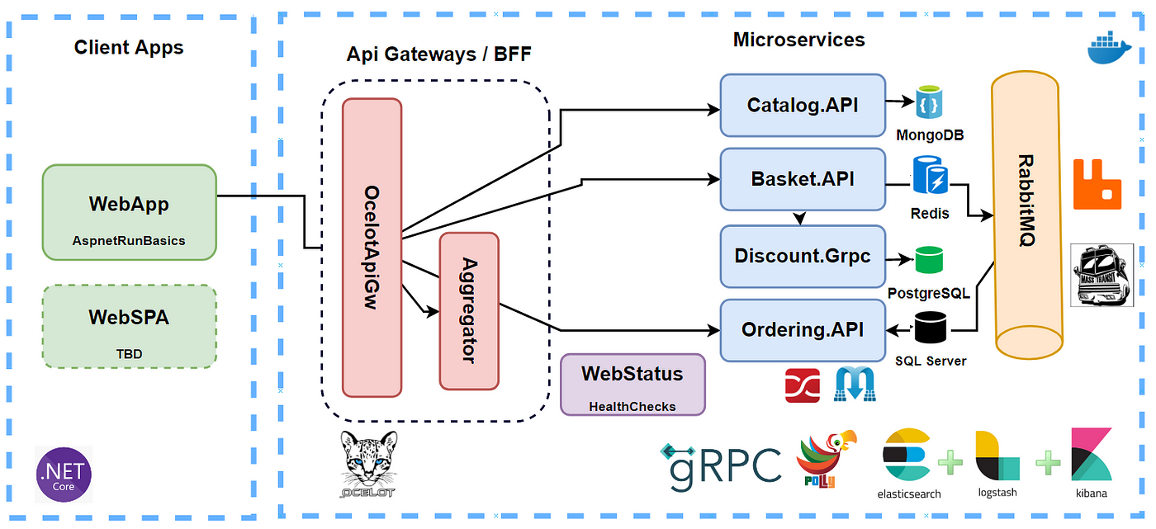
Microservices Architecture
12 Factor Microservice Rule
Authentication and Authorization, Encryption ( IdentityServer, OAuth 2.0, JWT), SSL/TLS
API Gateway(Ocelot, Azure API Management)
Logging and Monitoring (ELK Stack (Elasticsearch, Logstash, Kibana)/ New Relic, Azure application Insight, log Analytics
Service Discovery (Consule, Kubernetes Services)
Fault Tolerance(Circuit Breakers-Polly, retries, timeouts)
Database Scaling (sharding, replication)
Load Balancing-Kubernetes Ingress Controllers, Azure load balancer
Distributed Tracing(Application Insights, OpenTelemetry)
Autoscaling (Kubernetes Horizontal Pod Auto scaler (HPA)
Microservices Communication- RESTful APIs, gRPC, Messaging Queues (RabbitMQ, Kafka)
Health Checks - Kubernetes Probes, ASP.NET Core Health Checks, Consul Health Checks
Containerization(Docker, Docker Swarm),Orchestration – Kubernetes
Continuous Integration/Continuous DeploymentCI/CD) -Jenkins, Github, Azure DevOps
Infrastructure as Code (IaC) – Terraform, ARM Template, Bicep
Async, Middleware, SonarQube, Resharper. Code Analysis, Branching Strategy

Slide 15
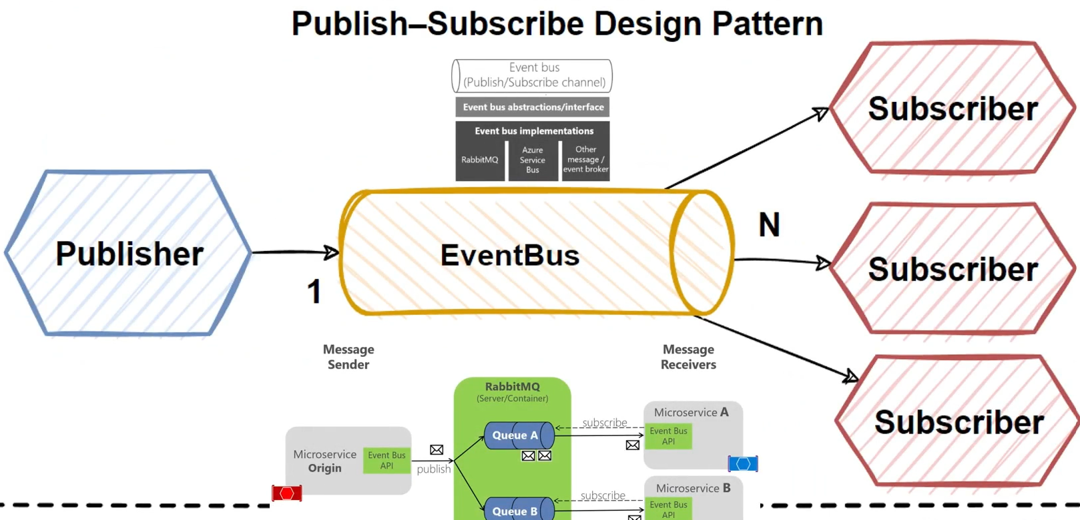

Slide 16
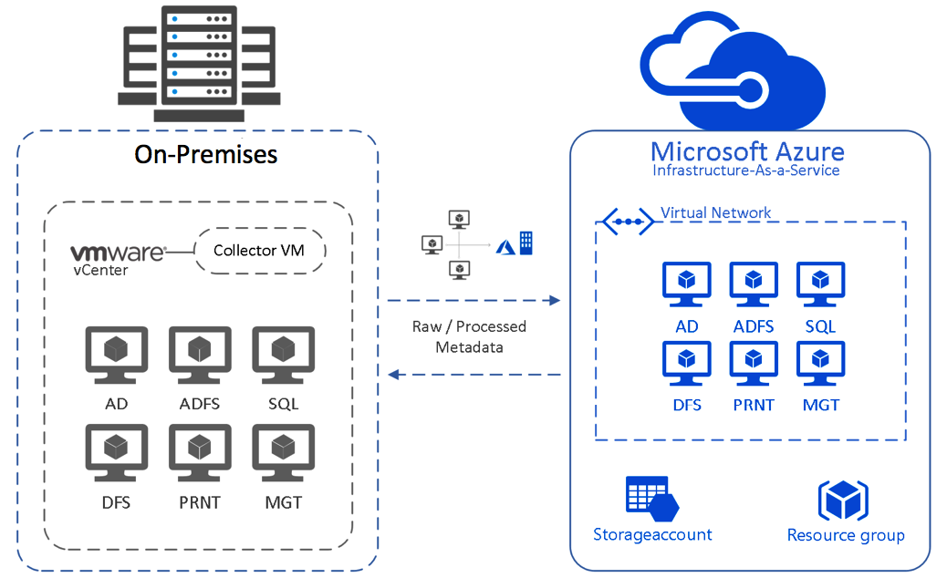
Notes:
https://www.linkedin.com/pulse/vm-azure-migration-mohamed-hesham/

Slide 17
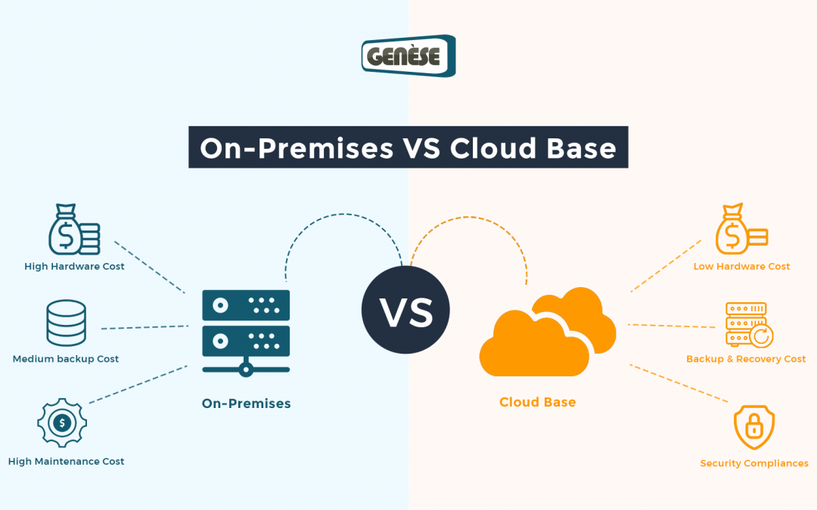
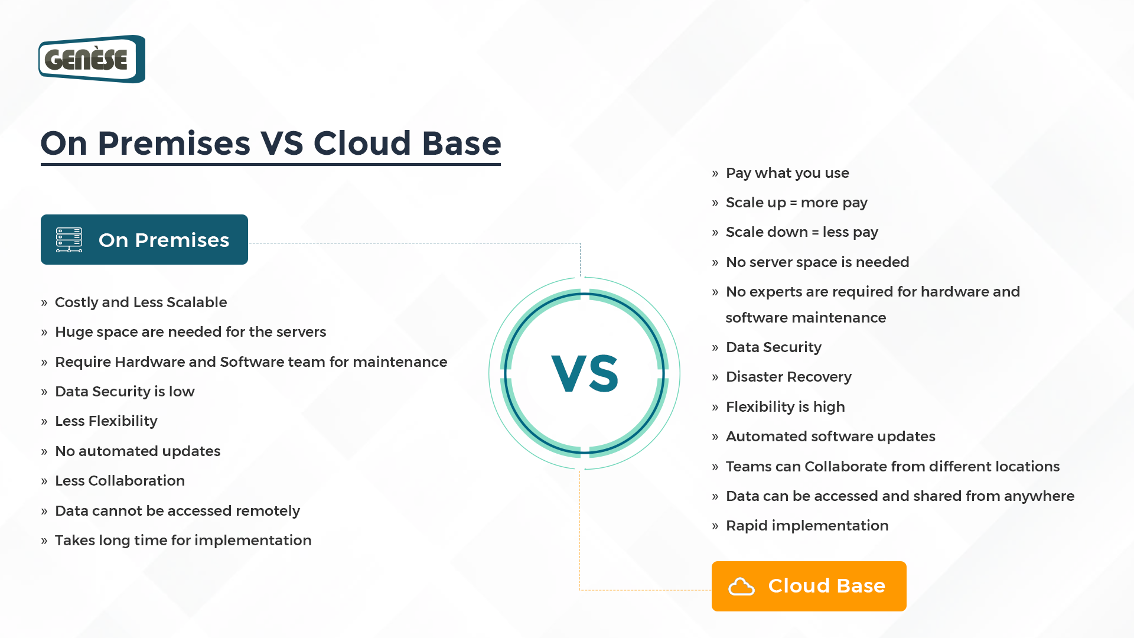

Slide 18
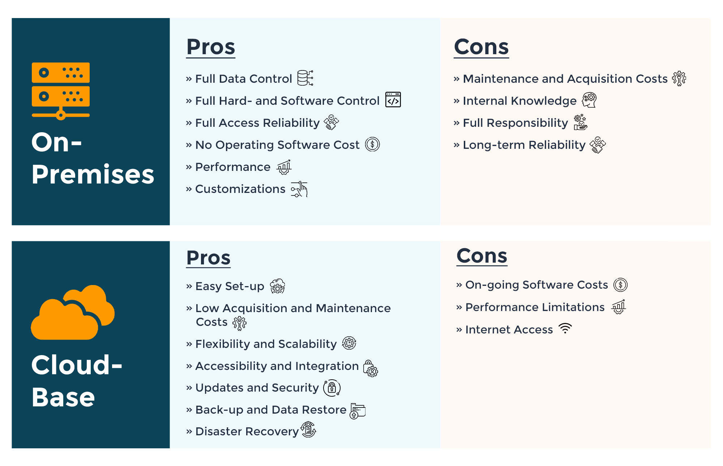

Slide 19
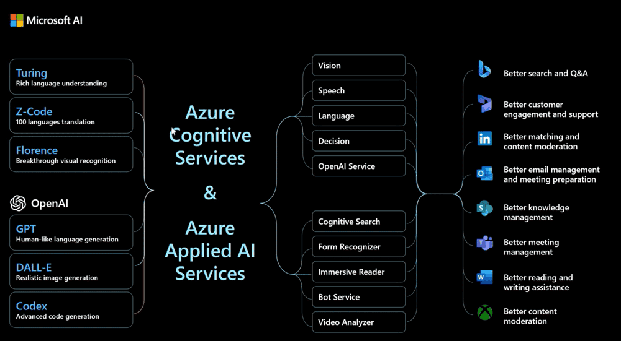

Slide 20
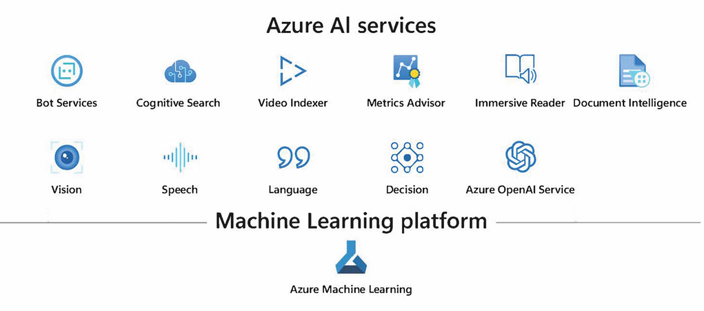

Slide 21
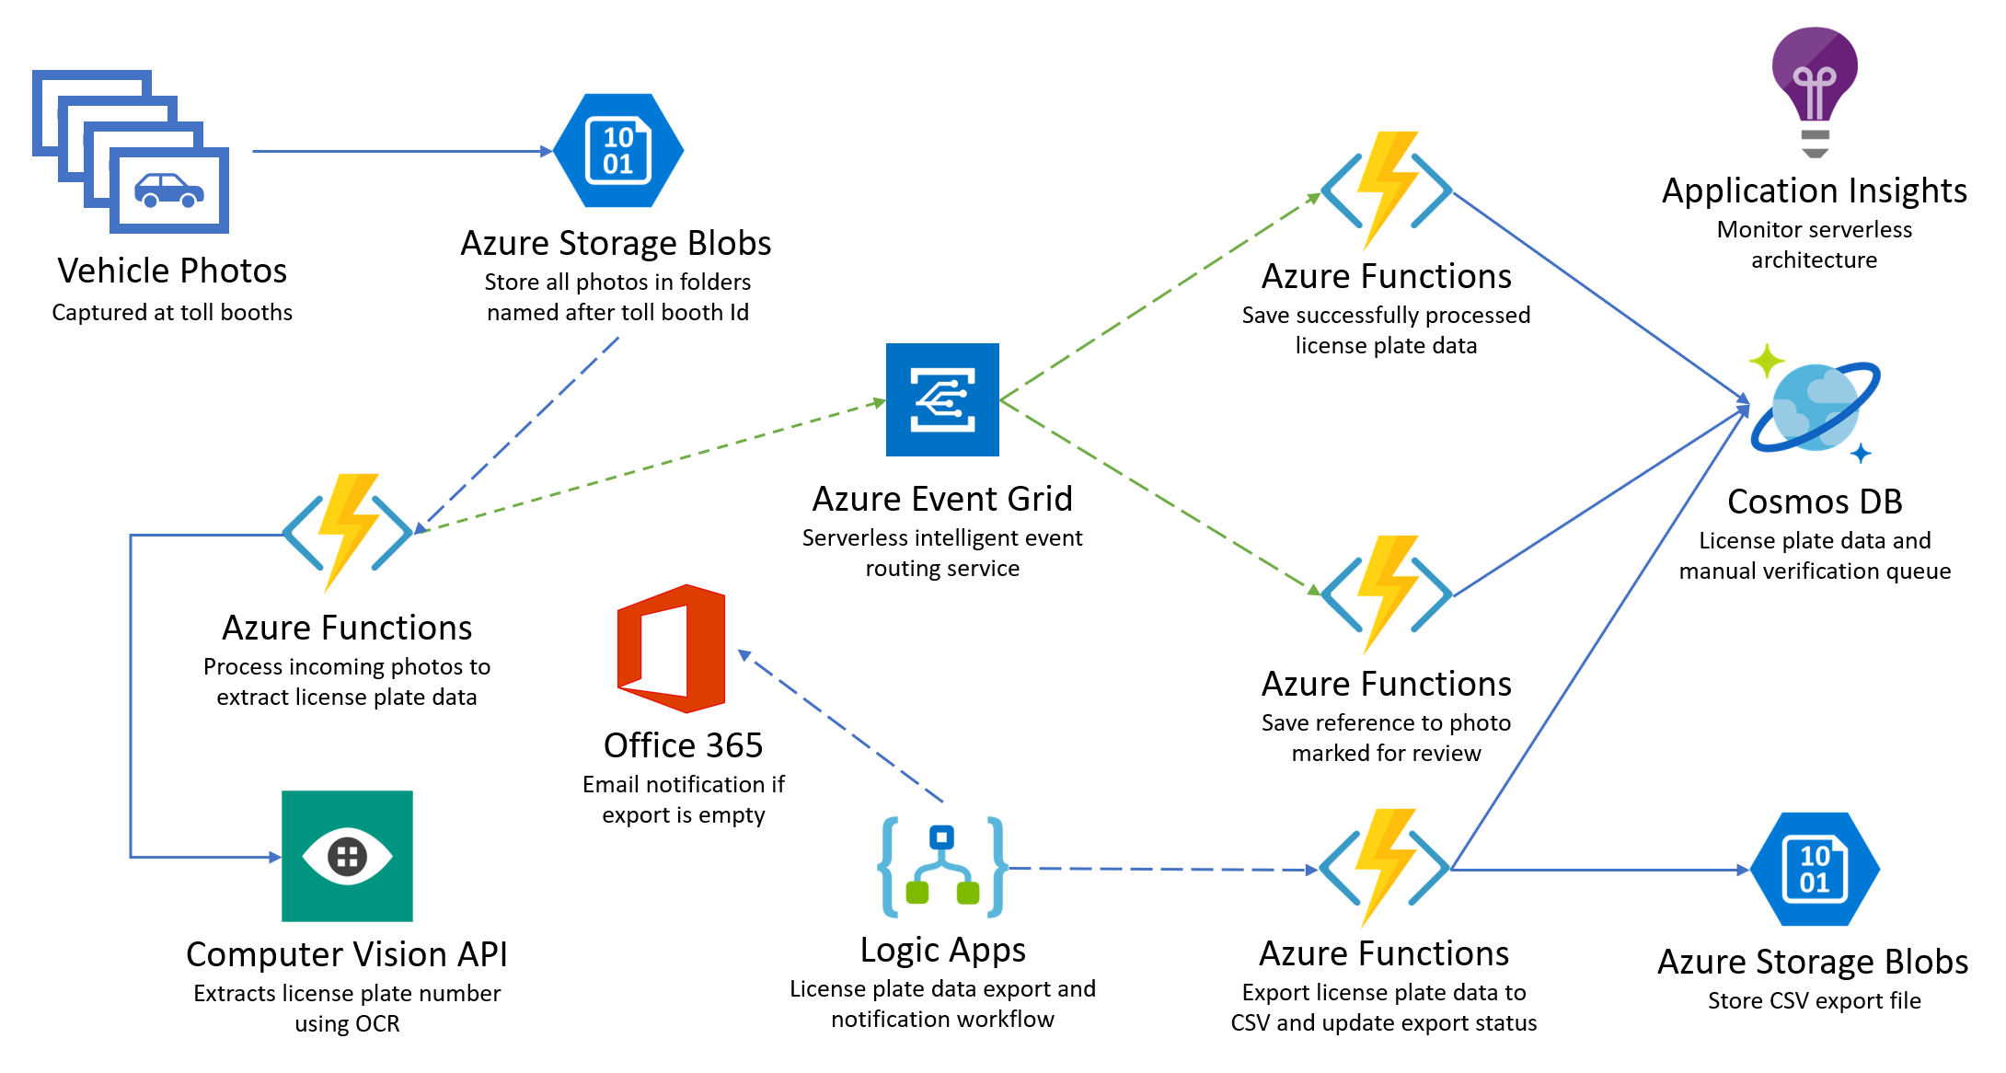

Slide 22
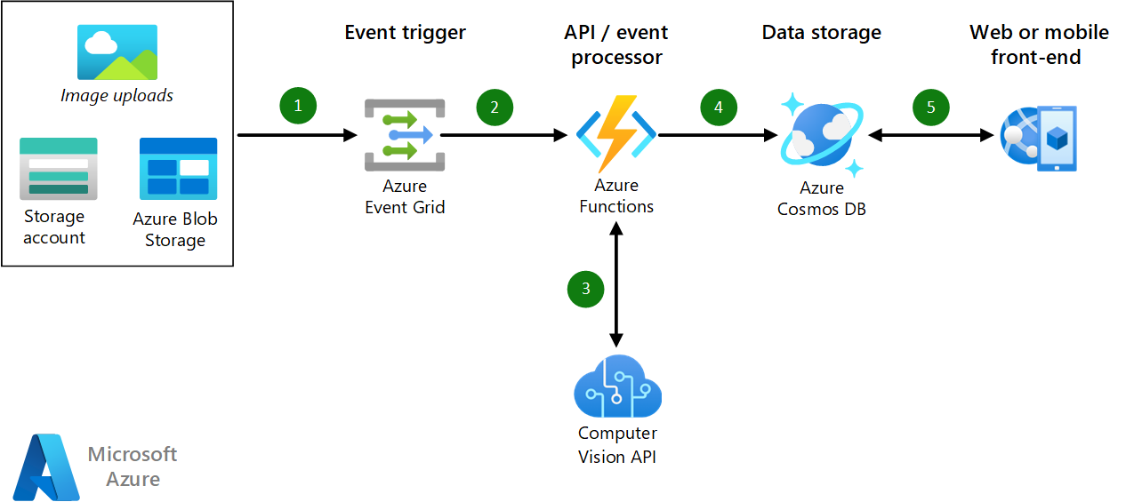

Slide 23
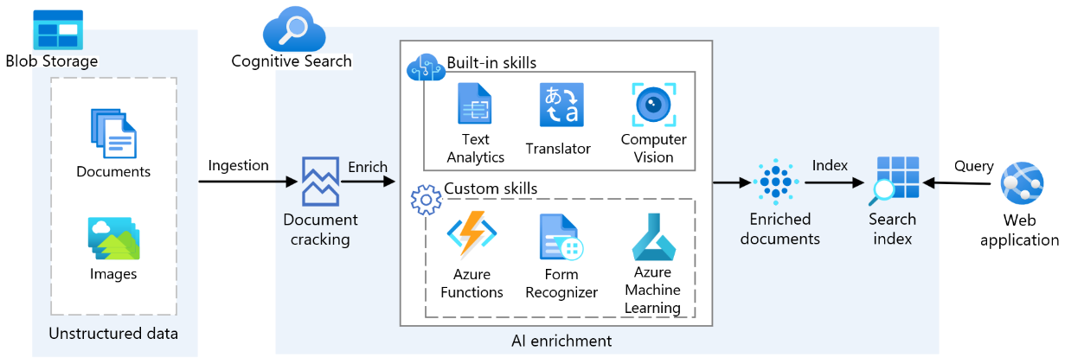

Slide 24
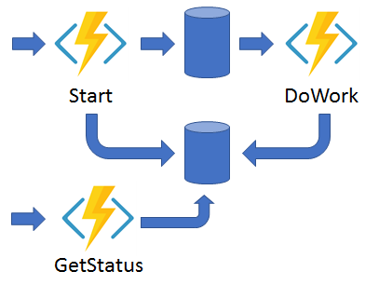
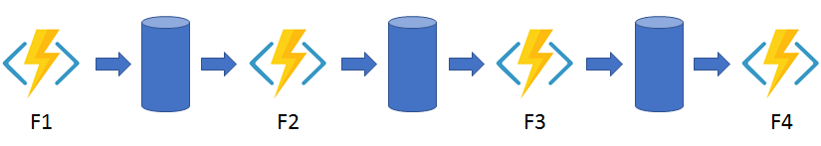
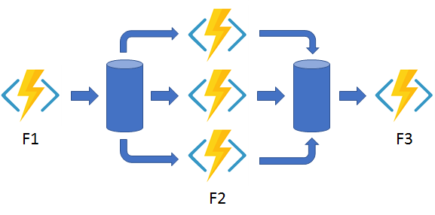
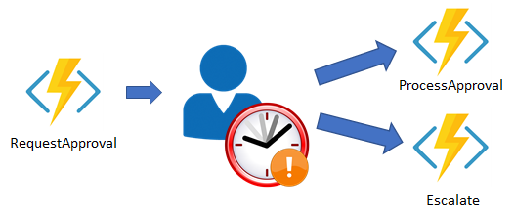
Azure Function
Function chaining
Fan-out/fan-in
Async HTTP APIs
Monitoring
Human interaction
Aggregator (stateful entities)

Slide 25
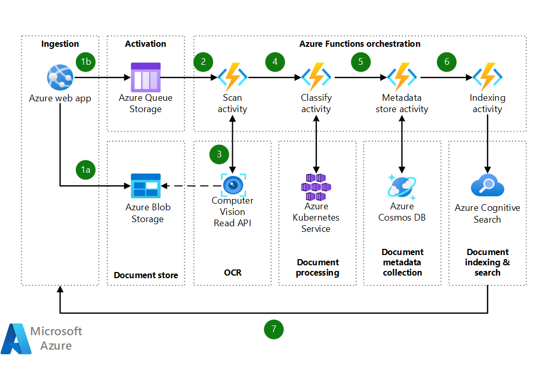

Slide 26
Azure Automation Runbook
1. Starting and Stopping VMs
2. Automating Resource Tagging -Ensure all resources are tagged correctly for better cost management and organization.
3. Automated Backup -Automate the backup of Azure SQL Databases.
4. Monitoring and Alerting -Set up alerts for resource thresholds and send notifications.
5. Cleaning Up Unused Resources - clean up unused or idle resources to optimize costs.

Slide 27
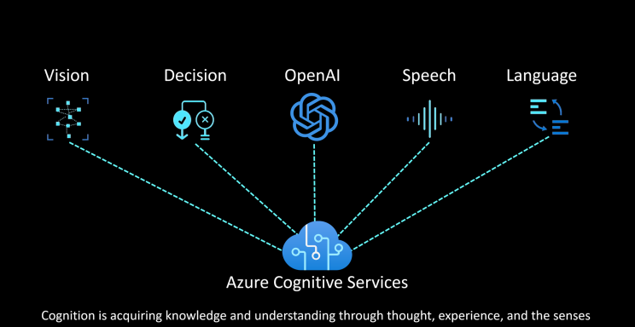

Slide 28
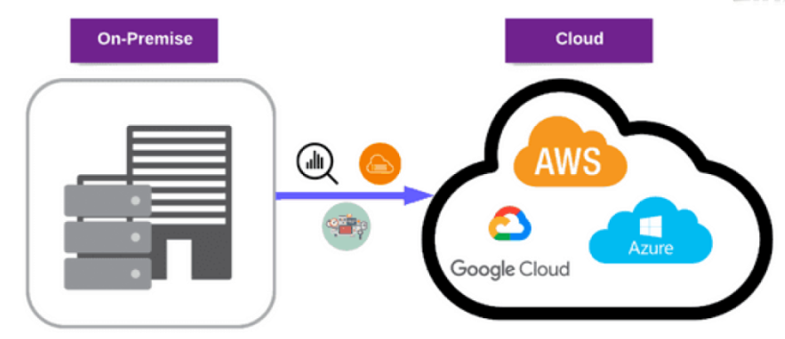

Slide 29
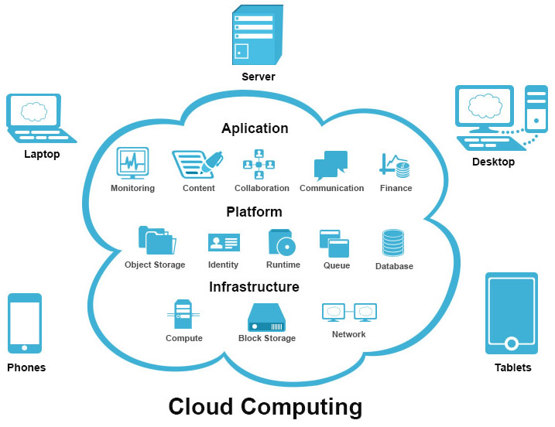

Slide 31
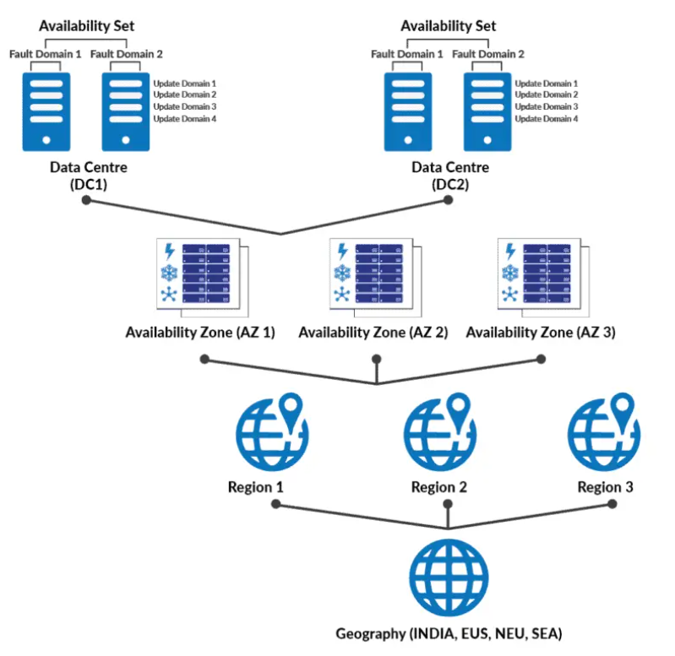
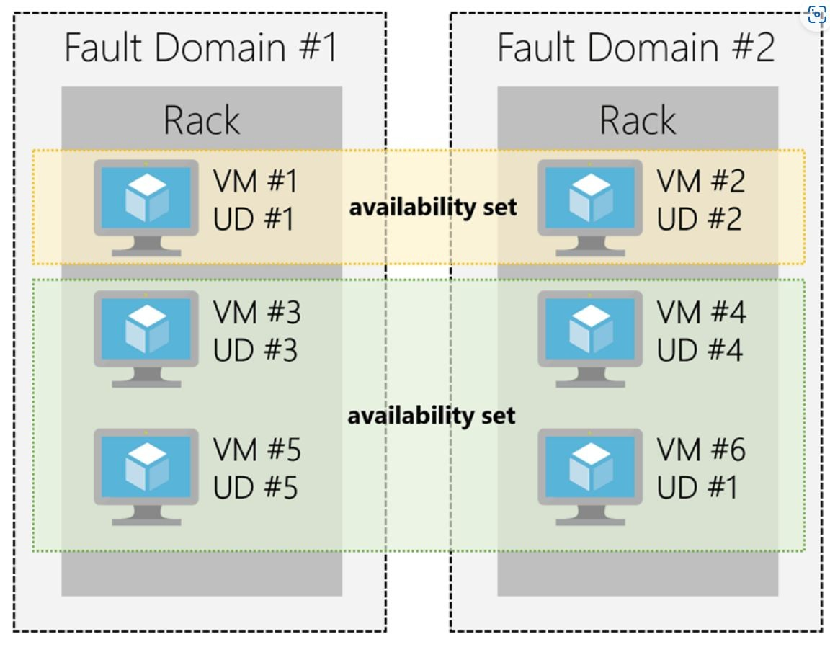

Slide 32
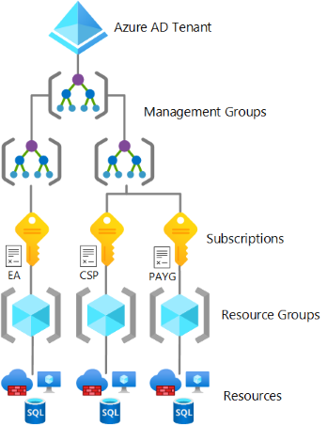
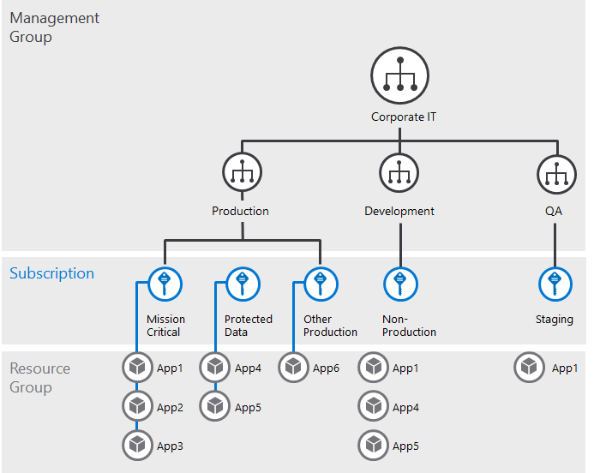

Slide 33
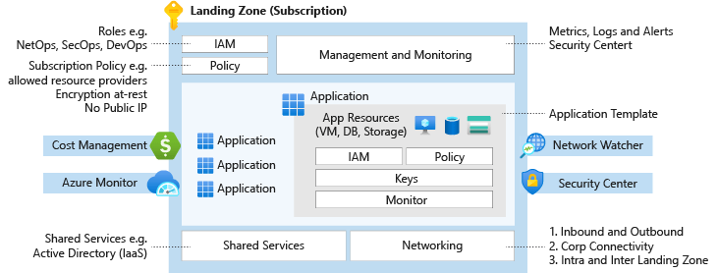
Landing Zone
1. IAM, Policy, Management & Monitoring (Role: NetOps, SecOps, DevOps, Subscription, Policies)
Azure Monitor, Azure app( VM, DB, Storage, IAM, Policies, Monitor)
2. Azure Cost Management
3. Azure Monitor
4. Network Watcher
5. Security Center
6. Shared Services

Slide 34
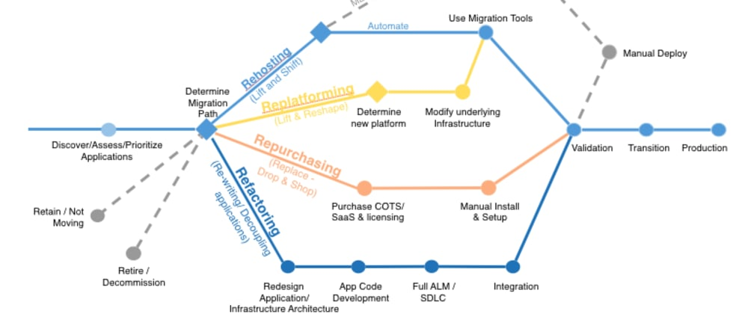
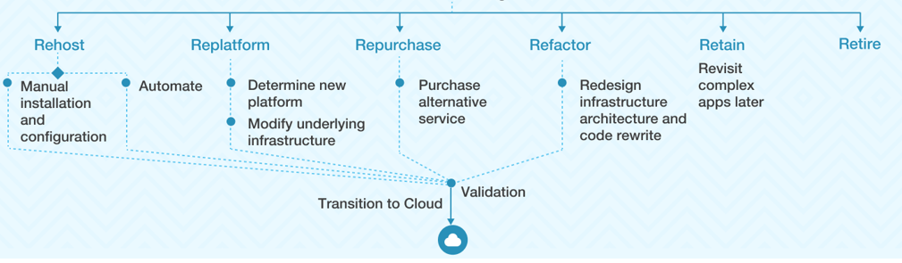
6R Strategy

Slide 35
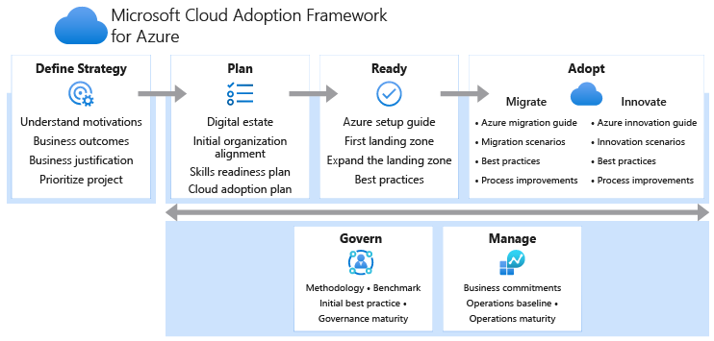
Cloud Adoption Framework (CAF)

Slide 36
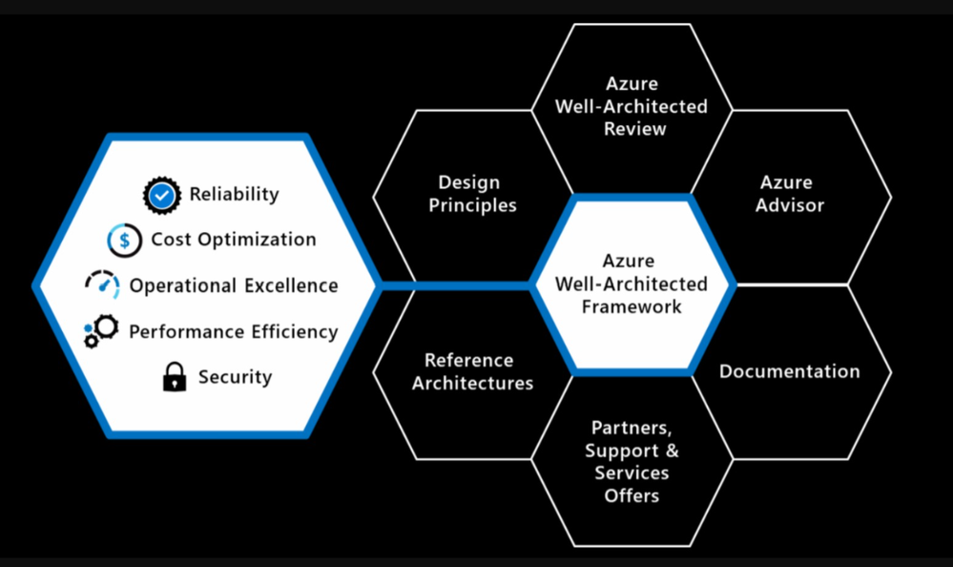

Slide 37
1 | Compute | Azure Virtual Machines, VMSS
 |  | Azure App Service
 |  | Azure Functions
 |  | Azure Kubernetes Service (AKS)
 |  | Azure Batch
2 | Storage | Azure Blob Storage
 |  | Azure Files
 |  | Azure Disk Storage
 |  | Azure Data Lake Storage
 |  | Azure SQL Database
 |  | Azure Storage Explorer
3 | Network | Azure Virtual Network (VNet)
 |  | Azure Load Balancer
 |  | Azure Traffic Manager
 |  | Azure Application Gateway Azure front door
 |  | Azure VPN Gateway
 |  | Azure ExpressRoute
4 | Security | Azure Security Center
 |  | Azure Active Directory (Azure AD) - B2B, B2C
 |  | Azure Key Vault
 |  | Azure Sentinel
 |  | Azure DDoS Protection
5 | Backup and Recovery | Azure Backup
 |  | Azure Site Recovery
 |  | Azure Archive Storage
 |  | VM backup, DB Backup, RTO, RPO
 |  | Azure Blob Storage - Lifecycle Management
6 | Operational Services | Azure Monitor
 |  | Azure Log Analytics
 |  | Azure Automation
 |  | Azure Cost Management
 |  | Azure DevTest Labs
7 | Data Base (SQL & No SQL Database) | Azure SQL Database (Backup, shredding, elastic pool)
 |  | Azure SQL Management Instance
 |  | Azure CosmosDB (azure cosmosdb emulator)
8 | Other Services | Azure DevOps
 |  | Azure Cognitive Services
 |  | Azure AI & Machine Learning
 |  | Azure IoT Hub
 |  | Azure Logic Apps
 |  | Azure Event Grid, Azure Event Hub, Azure Service Bus
 |  | Azure APIM, Azure Data Factory, Data bricks
 |  | Azure Bastion,Azure Policy,Azure BluePrint,ARM Template, Bicep

Slide 38
Azure Compute Services
• Virtual Machines (VMs):
Azure VMs provide scalable compute capacity in the cloud. You can choose from a wide range of VM types to meet specific performance and workload requirements.
• Azure App Service:
Azure App Service is a fully managed platform for building, deploying, and scaling web apps and APIs. It supports various programming languages and frameworks.
• Azure Functions:
Azure Functions is a serverless compute service that lets you run event-triggered code without provisioning or managing infrastructure.
• Azure Batch:
Azure Batch enables large-scale job scheduling and high-performance computing (HPC) batch processing in the cloud.
• Azure Kubernetes Service (AKS):
AKS is a managed Kubernetes service that simplifies deploying, managing, and scaling containerized applications using Kubernetes orchestration capabilities.
• Azure Container Instances (ACI):
ACI offers the fastest and simplest way to run a container in Azure, without managing virtual machines.

Slide 39
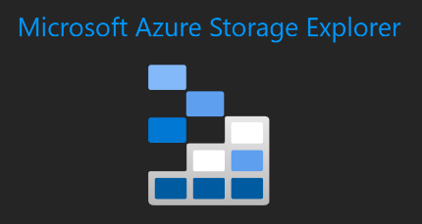
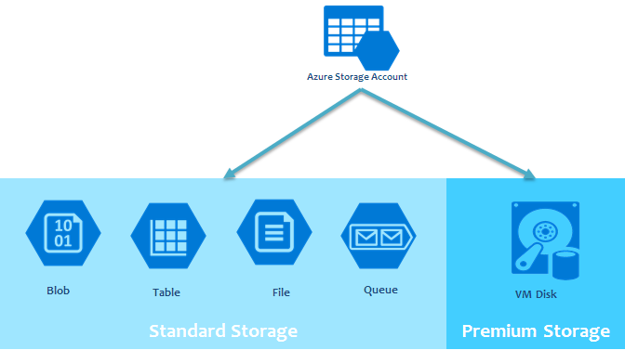
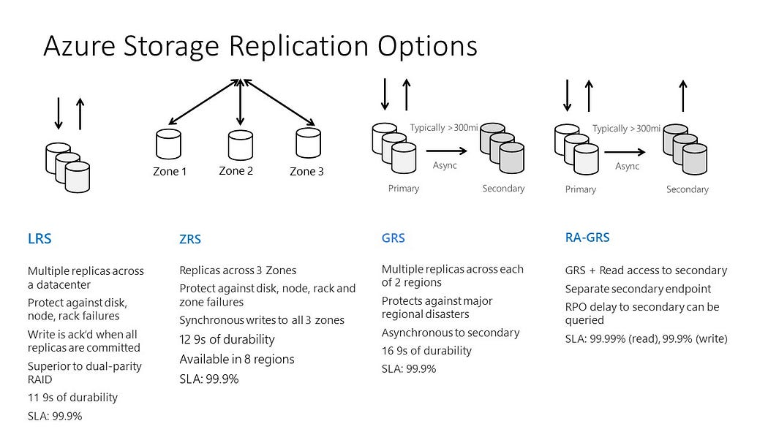
Azure Storage

Slide 40
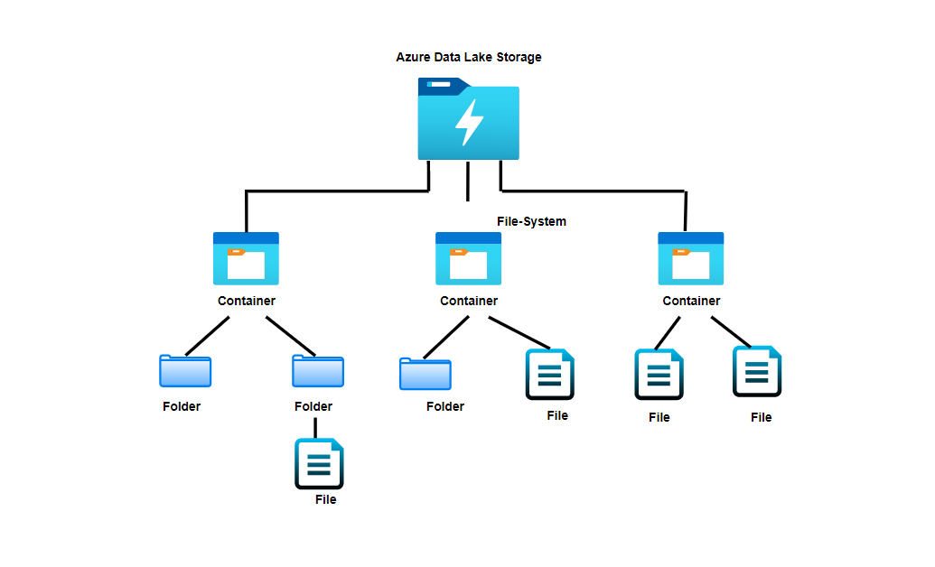
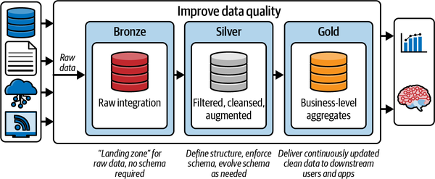
Azure Data lake storage (ADLS)

Slide 41
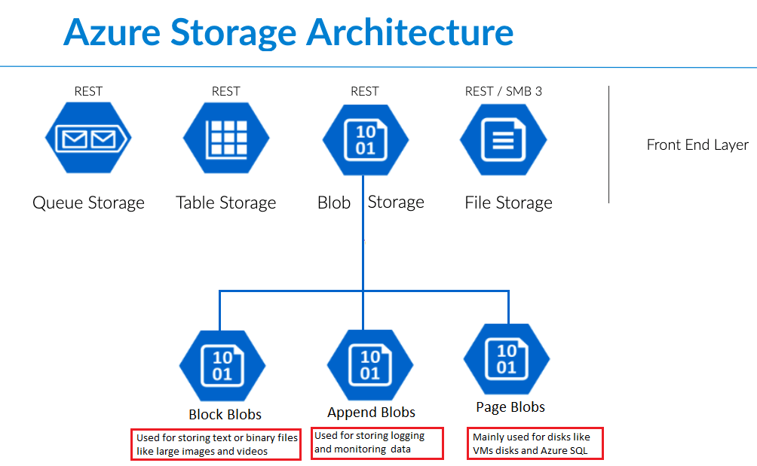

Slide 42
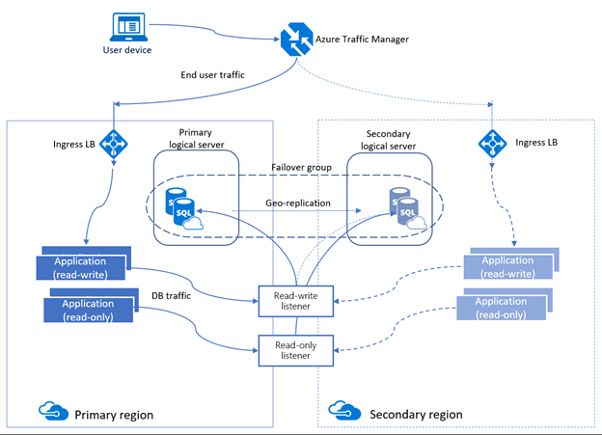

Slide 43
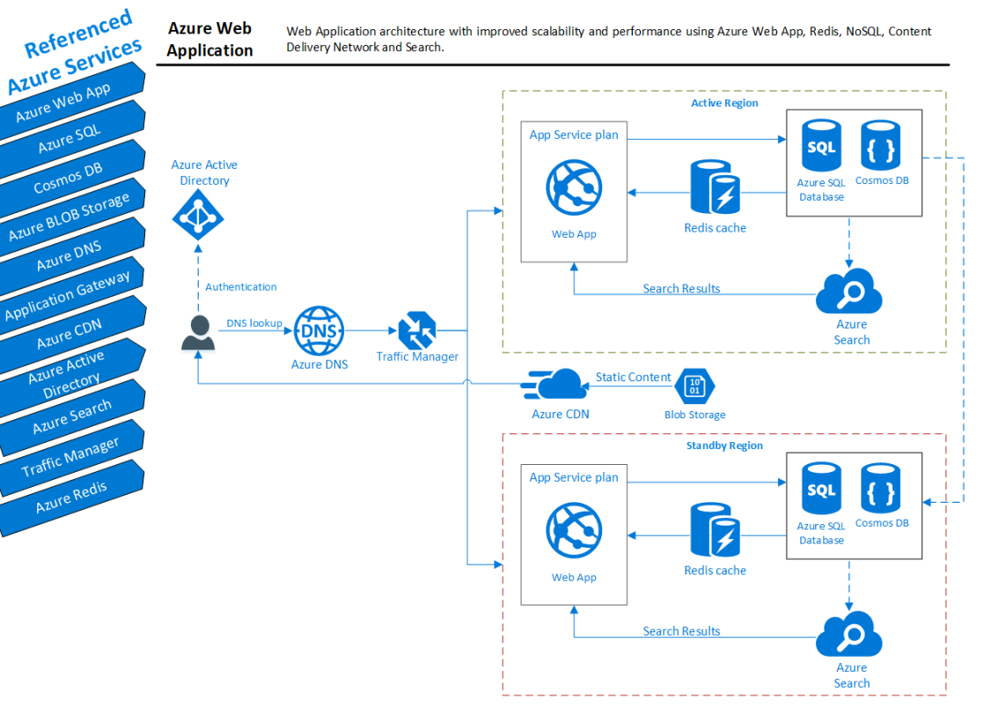

Slide 44
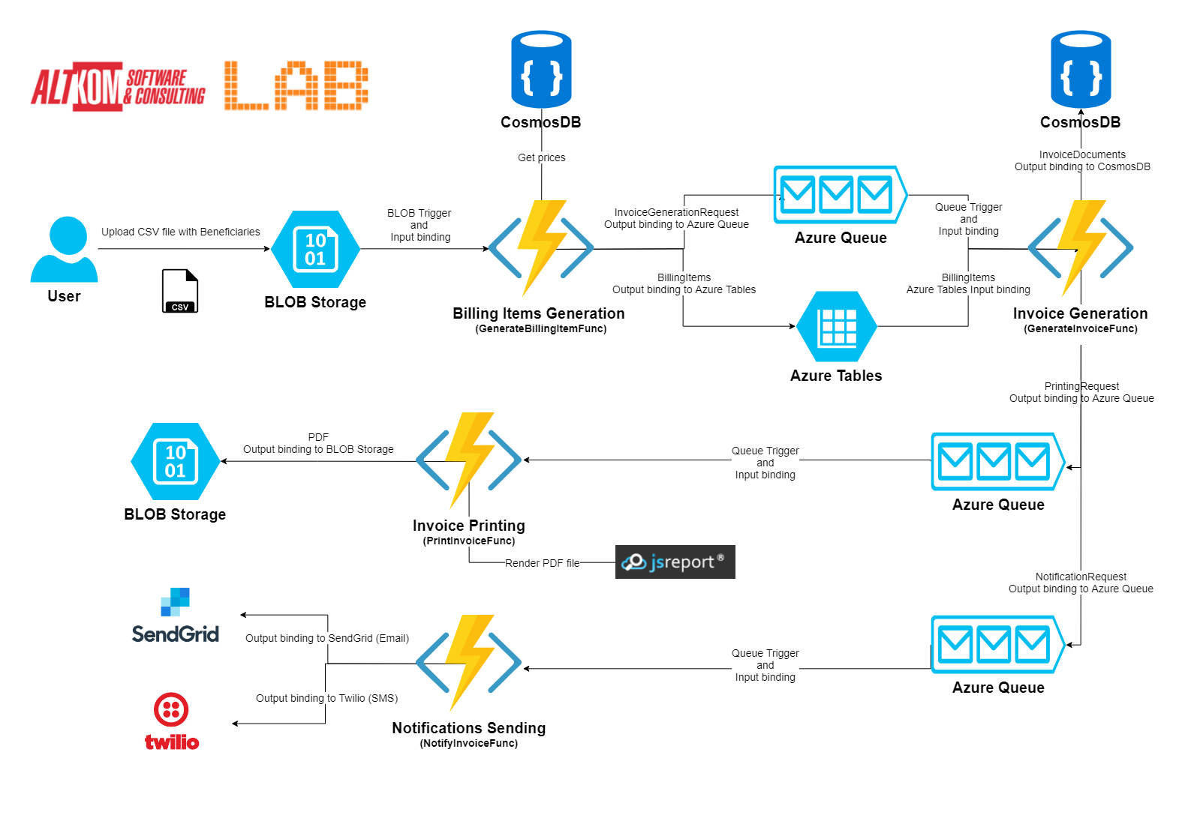

Slide 45
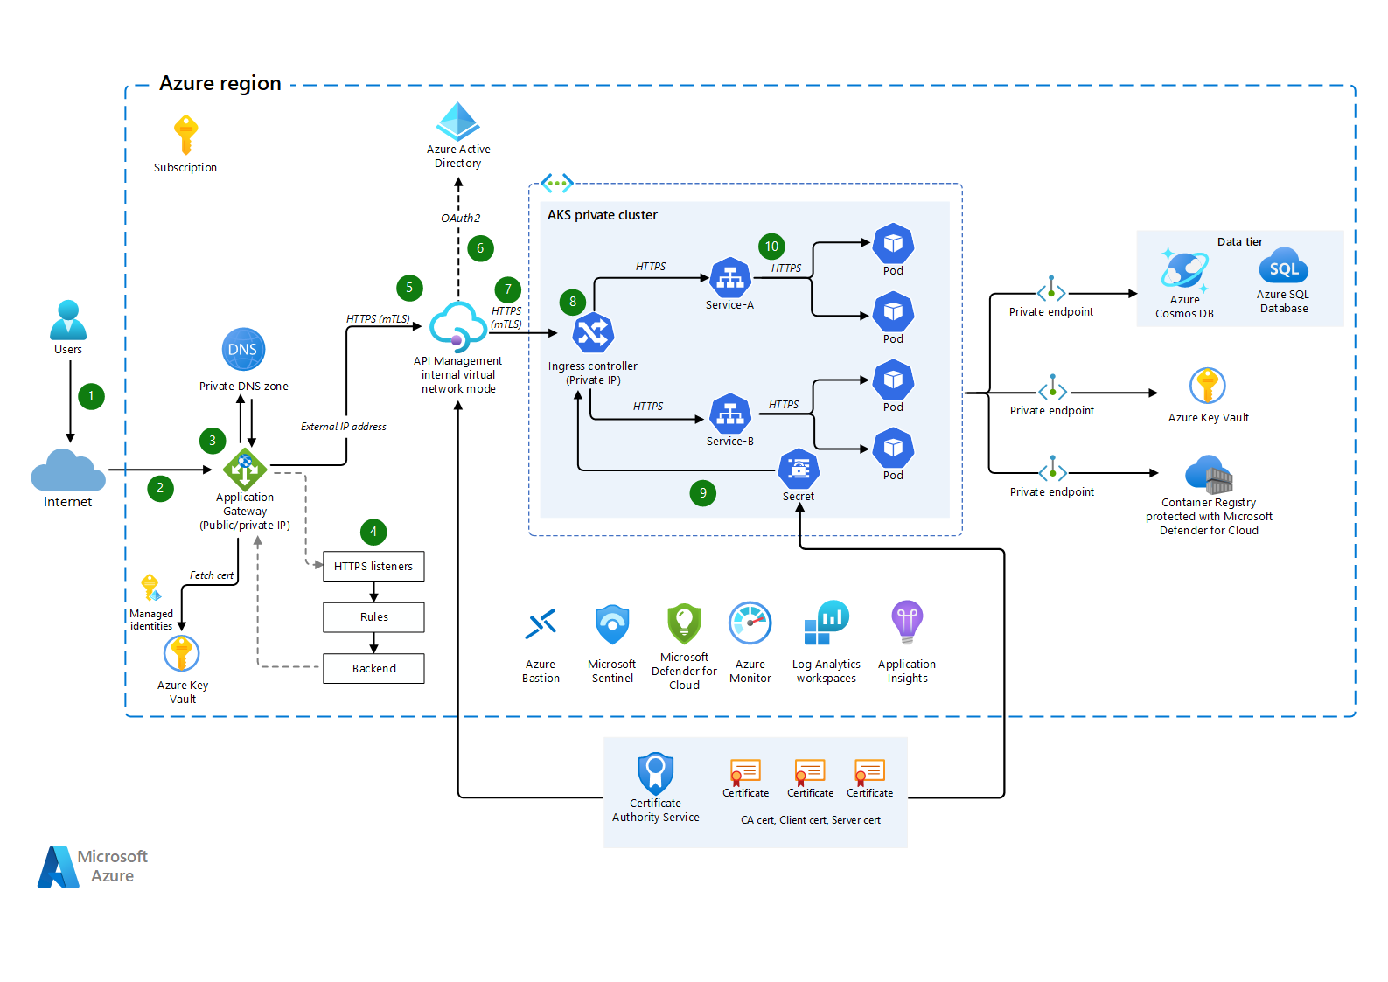
Azure API Management

Slide 46

Azure Durable Function

Slide 47
1. LRS, GRS, ZRS, GZRS 2. Storge Type – Blob, File, Table, Queue, Disk 3. Blob (block blob, Page blob, Append Blob)
Azure Storage

Slide 48


Slide 49



Slide 50
1. Identity & Access Management Azure Active Directory (User, Group, Role), AD Connect, App Registration(web App, APIs) Azure API Management (Developer Portal, API Gateway, APIs), Security – Using Certificate, OAuth, Subscription, Policies) 2. Azure Managed identity vs User defined Identity 3. Database Security 4. Application Security 5. Network Security 6. Storage Security 7. Governance 8. Monitor, Application Insight, Log Analytics, Kusto Query
Azure Security

Slide 51


Slide 52


Slide 53


Slide 54



Azure AD & APIM

Slide 55

Azure application insight
Application Insights is an extension of Azure Monitor and provides application performance monitoring (APM) features. APM tools are useful to monitor applications from development, through test, and into production in the following ways: Proactively understand how an application is performing.

Slide 56

Azure Log Analytics

Slide 57


Slide 58


Azure Event Grid, Event Hubs, Service Bus

Slide 59

Azure application Gateway, Azure traffic manager, Azure frontdoor(Global), Azure load balancer(Global)

Slide 61
Azure Services

Slide 62

Microservices
(Azure APIM),
(12 Factor, Microservices APIs, Security, logging,Monitoring, DR, Backup, Revision), Version, Revision, Subscription, Products, Inbound, outbound Policies. Security( Subscription, Products, Oauth, Certification) Developer Portal, Apis, Apps Gateway,
Deploy Secure Azure Function & Durable function, Orchestration and event trigger, Binding, Cloud Design Pattern
Azure Services
(Compute, Storage, Security, Networking, Operation)
Networking, Firewall, Policies, Data, Storage, backup, Azure Well Architecture Framework (Reliability, Cost Optimization, Operation Excellence, Performance, Security), Azure Networking (Site to Site, Site to Point, Point to Site), Load Balacer( Azure load balancer, Azure front door, Azure Traffic Manager, Azure application gateway), Advisor, Sentinel, DDOS Protection, Blueprint,
Azure Migration
(Migration On-Premise app to Azure, Migration Strategy, 6R( Rehost, Re-platform, Repurchase, Refactor, Retain, Retire),Cloud Adaption Framework(Strategy, Plan, Ready, Adopt, Govern, Manage, Backup, DR)
Azure DevOps CICD Pipeline
(Linux Ubuntu Server Commands, Classic editor, Docker, ACR, AKS, Kubernetes Role Base Security), YAML (Node, Pod, Replicaset, Services,Deployment, Namespace, Storage, Configruation, Secret, Cluster Role, Role Binding, HPA, Node pool), Azure DevOps(classic editor, Variable group, Pipeline,
Release Pipelines to deploy across Environments (Dev,QA)

Slide 63
Scrum Methodology Product owner/ Scrum Master. Scrum Team
User Story(Feature Branch)
Master Branch(Pull Request)
PR CICDpipeline
Docker
Kubernetes
Blue green Deployment
Pipeline /Stage/Steps

Slide 67




















Azure Services Integrated with AKS
Azure
Disks
Azure
Public IP
Azure
AD
Azure
Container
Registry
Azure
Kubernetes
Service
Standard
Load
Balancer
AD
Groups
AKS
Linux & Windows
Nodepools
Azure
MySQL
Azure
DevOps
Azure
Files
Virtual
Network
AD
Users
Azure
Build & Release
Pipelines
Azure
VM
ScaleSets
Azure
DNS
Zones
Azure
Managed
Service
Identity
Storage
Account
Azure
Container Instances
Virtual Nodes
Subnets

Slide 68
Development Example

Slide 69
Reference Architecture (Example)
Billing Service (Azure function, Azure Table storage)
Azure API Management (Security, logging, Monitoring, API Communication)
Migrate Monolith web app and SQL Server on Azure (High available and scalable architecture)
High available Scalable and performance using Load balancer, web app, Redis, NOSQL, CDN, Search etc.

Slide 70


Slide 71


Slide 72
Azure DevOps

Slide 73
Docker - Fundamentals
nginxdemos/hello
Docker Daemon
Docker Registry
(Docker Hub)
nginxdemos/hello
Container-11
Images
Containers
Docker Host
docker pull nginxdemos/hello
Docker Registry or Docker Hub
A Docker registry stores Docker images.
Docker Hub is a public registry that anyone can use, and Docker is configured to look for images on Docker Hub by default.
We can even run our own private registry.
When we use the docker pull or docker run commands, the required images are pulled from our configured registry.
When we use the docker push command, our image is pushed to our configured registry.
docker run -p 82:80 -d nginxdemos/hello
Docker Client (My Desktop or Docker Host)

Slide 74
Kubernetes - Imperative & Declarative
Kubernetes Fundamentals
Imperative
Declarative
kubectl
YAML & kubectl
Pod
Pod
ReplicaSet
ReplicaSet
Deployment
Deployment
Service
Service

Slide 75


Azure AKS Cluster
http://<External-IP-from-get-service-output>
UserMgmt – LoadBalancer Service
Users
Load Balancer Service
Deployment
Web
App
Environment Variables
POD
ReplicaSet
Init Containers
Azure Disks
Deployment (UserMgmt)
MySQL – ClusterIP Service
Config Map
Storage Class
Environment Variables
Persistent Volume Claim
Volumes
MySql
AKS Storage Azure Disks
Persistent Volumes
Volume Mounts
POD
ReplicaSet
Deployment
Deployment (mysql)
ClusterIP Service

Slide 76
Azure AKS Cluster
http://<External-IP-from-get-service-output>
UserMgmt – LoadBalancer Service
Users
Load Balancer Service
Deployment
Web
App
Environment Variables
POD
ReplicaSet
Init Containers
Deployment (UserMgmt)
MySQL – ExternalName Service
High Availability
Monitoring & Alerting
AKS Storage Azure MySQL Database
Backup & Recovery
Automatic Upgrades
Read Replicas
Azure MySQL
Database
Secure Data at rest and motion

Slide 77
http://<External-IP-from-get-service-output>/app1/file1.html
Azure AKS Cluster
LoadBalancer Service
Users
Load Balancer Service
AKS Storage Azure Files
Deployment
NGINX
NGINX
NGINX
POD
POD
POD
Volumes
ReplicaSet
Deployment
Volume Mounts
Storage Class
Key Advantage with Azure File Shares:
Multiple pods can access the single file share
Azure Storage Account
Persistent Volume Claim
file1.html
file2.html
Persistent Volumes
</>
HTML
</>
HTML
Azure File Shares

Slide 78





Azure AKS & Nginx Ingress – Context Path Based Routing
Azure
Azure AKS Cluster
Nginx App1
/app1/
/app2/
/
Ingress Service
Nginx App2
Users
Public IP
for Ingress
Controller
Ingress Controller
AKS
Load Balancer
Usermgmt WebApp

Slide 79



Delegate Domain to Azure DNS
AWS Cloud
Azure Cloud
DNZ Zones
Domain Registrar
kubeoncloud.com
kubeoncloud.com
AWS Route53
Azure DNS Zones

Slide 80
Azure AKS Nginx Ingress Hostname based Routing External DNS
Azure
Azure AKS Cluster
Virtual Machine
Scale Sets
DNS
Zones
Managed
Service
Identity
Nginx App1
External DNS
eapp1.kubeoncloud.com
eapp2.kubeoncloud.com
eapp3.kubeoncloud.com
Nginx App2
Ingress Service
Users
Public IP
for Ingress
Controller
Ingress Controller
AKS
Load Balancer
Usermgmt WebApp

Slide 81


Azure AKS Nginx Ingress External DNS SSL with Lets Encrypt
Azure
Azure AKS Cluster
Virtual Machine
Scale Sets
External DNS
DNS
Zones
Managed
Service
Identity
cert-manager
sapp1.kubeoncloud.com
sapp2.kubeoncloud.com
Nginx App1
Ingress Service
Users
Public IP
for Ingress
Controller
Ingress Controller
AKS
Load Balancer
Nginx App2

Slide 82


Kubernetes – Requests & Limits
K8s cluster
K8s Node
default namespace
CPU: 8 vcores
(8000m)
Container-1
Container-2
Memory: 32GB
CPU: 500m
CPU: 1000m
CPU: 500m
CPU: 1000m
Mem: 128Mi
Mem: 500Mi
Mem: 128Mi
Mem: 500Mi
Requests
Limits
Requests
Limits

Slide 83
Kubernetes - Namespaces & DNS
K8s cluster
K8s Node
default namespace
dev namespace
qa namespace
App1
App1
App1
app1.default.svc.cluster.local
app1.dev.svc.cluster.local
app1.qa.svc.cluster.local
<service-name>.<namespace-name>.svc.cluster.local

Slide 84

Limit Range
LoadBalancer Service
LoadBalancer Service
LoadBalancer Service
F
F
F
Pod
Pod
Pod
Limit Range Manifest
ReplicaSet
ReplicaSet
ReplicaSet
Deployment
Deployment
Deployment
ClusterIP Service
ClusterIP Service
ClusterIP Service
B
B
B
Pod
Pod
Pod
ReplicaSet
ReplicaSet
ReplicaSet
Deployment
Deployment
Deployment
Deployment
CPU
Memory
CPU
Memory
CPU
Memory
default
Min/Max
default
Min/Max
default
Min/Max
Limit Range (Per Container)
Limit Range (Per Container)
Limit Range (Per Container)
Namespace: dev
Namespace: qa
Namespace: staging

Slide 85

Resource Quota
LoadBalancer Service
LoadBalancer Service
LoadBalancer Service
F
F
F
Resource Quota Manifest
Pod
Pod
Pod
ReplicaSet
ReplicaSet
ReplicaSet
Deployment
Deployment
Deployment
ClusterIP Service
ClusterIP Service
ClusterIP Service
B
B
B
Pod
Pod
Pod
ReplicaSet
ReplicaSet
ReplicaSet
Deployment
Deployment
Deployment
Deployment
CPU
Memory
CPU
Memory
CPU
Memory
Pods
Services
Pods
Services
Pods
Services
Resource Quota
Resource Quota
Resource Quota
Namespace: dev
Namespace: qa
Namespace: staging

Slide 86
Azure AKS Virtual Nodes
Virtual Kubelet
Azure Container Instances
ACI
Azure Virtual Nodes on
AKS
+
=

Slide 87
Azure AKS - Virtual Nodes
Azure Cloud
Azure AKS Cluster
VNET1
AKS Cluster
Control Plane
Node Pool
Virtual Nodes
Azure Container Instance - ACI
Subnet: default
Subnet: virtual-node-aci

Slide 88




Azure AKS - Virtual Nodes Mixed Mode Deployments
Azure Cloud
Azure AKS Cluster
VNET1
MySQL Cluster IP Service
UserMgmt LoadBalancer Service
MySQL Pod
Usermgmt Pod
Virtual Node
AKS Worker Node
Node Pool
Azure Container Instance - ACI
Subnet: default
AKS Cluster
Control Plane
Subnet: virtual-node-aci
Azure Disks

Slide 89

Azure ACR and AKS - Integration
Docker Developer
Azure Cloud
Azure Container
Registry
Azure AKS Cluster
Build and Push
Docker Image
Integrate ACR and AKS
Azure AKS Cluster
Control Plane
Pull Docker Image from ACR
http://<public-ip>
Users
Public IP
App1 LB
Nginx App1
AKS
Load Balancer

Slide 90
Pull Docker Images from ACR using Service Principal
Run on Azure AKS Nodepools
Docker Developer
Azure Cloud
Azure Container
Registry
Azure AKS Cluster
Build and Push
Docker Image
Azure AKS Cluster
Control Plane
Pull Docker Image from ACR
docker-server
docker-username
http://<public-ip>
docker-password
Users
Public IP
App1 LB
Nginx App1
AKS
Load Balancer

Slide 91
Pull Docker Images from ACR using Service Principal
Run on Azure Virtual Nodes
Docker Developer
Azure Cloud
Azure Container
Registry
Azure AKS Cluster
Azure AKS Cluster
Control Plane
Build and Push
Docker Image
Pull Docker Image from ACR
docker-server
docker-username
docker-password
http://<public-ip>
Nginx App1
Users
Public IP
App1 LB
Virtual Node - ACI
AKS
Load Balancer

Slide 92


Azure DevOps Pipelines – Build & Push Docker Image to ACR
Azure Cloud
Azure DevOps
Github
Azure Pipelines
(Build & Push)
Azure Container Registry
Developer

Slide 93
Azure DevOps – Build & Push Docker Image to ACR & Deploy to AKS
Azure DevOps
Azure Cloud
Developer
Azure Pipelines
1
2
Stage-1: Build & Push to ACR
4
Stage-2: Deploy to AKS
Github
5
Azure AKS Cluster
3
default namespace
Nginx App1
6
Azure Container Registry

Slide 94
Azure Pipelines – Key Concepts
Pipeline
Stages
Steps
Trigger
Stage-1: Build
Agent
Step-1: script: echo Hello, world!
Job
Stage-2: AA
Step-2: Task-1: Docker Build & Push to ACR
Github
Agent
Stage-3: BB
Job
Step-3: Task-2: Copy Files to Build Artifact Directory
Stage-4: CC
Job
Step-4: Task-3: Publish Artifacts to Azure Pipelines
Developer

Slide 95

Azure Pipelines – Key Concepts
Stages
Stage-1
Jobs
Job-1
Steps
Step-1: Script
Step-2: Task
Job-2
Steps
Step-1: Task
Step-2: Task
Stage-2
Jobs
Job-1
Steps
Step-1: Script
Step-2: Script
Job-2
Steps
Step-1: Task
Step-2: Task

Slide 96

Azure Pipelines – Starter Pipeline
Goal
Create a Pipeline that will build docker images, push them to Azure Container Registry and Publish Kubernetes Manifests to Azure Pipelines
Part-1
Semi Customized
Part-2
Fully Customized using Starter Pipeline
Task-1
Use pre-defined Docker Build & Push Pipeline
Task-1
Start using Starter pipeline and use Docker Build or Push Docker Images Task
Task-2
Customize Pipeline to Use Copy Files Task
Task-2
Customize Pipeline to Use Copy Files Task
Task-3
Customize Pipeline to Use Publish Build Artifacts Task
Task-3
Customize Pipeline to Use Publish Build Artifacts Task

Slide 97

Azure DevOps – Release Pipelines
To achieve Continuous Delivery we use Release Pipelines

Slide 98

Azure DevOps – Release Pipelines

Slide 99



Developer
Github
Azure DevOps – Release Pipelines
1
2
Azure Cloud
Azure DevOps
Release Pipelines
QA
Azure Pipelines
7
Stage-1: Build & Push to ACR
4
Dev
Staging
12
Prod
3
10
Azure Container Registry
6
5
9
8
Azure AKS Cluster
12
11
14
13
dev namespace
qa namespace
Staging namespace
prod namespace
Nginx App1
Nginx App1
Nginx App1
Nginx App1

Slide 100

Azure Release Pipelines

Slide 101

Azure Release Pipelines - Releases

Slide 102
Azure AKS HTTP Application Routing Add On Ingress + External DNS (Automatic Install)
Azure Cloud
Azure AKS Cluster
app1.7b8803340f38495c8402.centralus.aksapp.io
7b8803340f38495c8402.centralus.aksapp.io
DNS Zones
Nginx App1
External DNS
app1.7b8803340f38495c8402.centralus.aksapp.io
app1.7b8803340f38495c8402.centralus.aksapp.io
Users
Public IP
for Ingress
Controller
Ingress Controller
Ingress Service
AKS
Load Balancer
HTTP Application Routing Add On

Slide 103





Azure AKS Cluster Access
AKS Cluster - 1
AKS Cluster-1
kubectl
Current Context
AKS Admin
AKS Cluster-2
AKS Cluster - 2

Slide 104



Azure Active Directory Authentication for AKS Admins
Integrate Azure AD and AKS Cluster
Azure Active Directory
Azure AKS Cluster
Azure AD Group: k8sadmins
Your Desktop
kubectl
K8S API Server
Azure AD User: user1aksadmin
Terminal

Slide 105

Azure Active Directory Authentication for AKS Admins
Authentication
Your Desktop
Azure AKS Cluster
Terminal
2
Browser
1
kubectl get nodes
Azure Active Directory
4
3
Credentials Cached
Azure AD User: user1aksadmin
K8S API Server
Azure AD Group: k8sadmins

Slide 106
Kubernetes RBAC
Kubernetes RBAC - Fundamentals
Subjects
API Groups
Resources
Verbs
Users or processes that need access to the Kubernetes API
The k8s API objects that we grant access to
List of actions that can be taken on a resource
Kind: Group, User
core
Pods
Create
Patch
Kind: Service Account
extensions
Deployments
List
get
apps
Services
Watch
Replace
batch
StatefulSets
Delete
Read
Reference: https://kubernetes.io/docs/reference/generated/kubernetes-api/v1.19

Slide 107


Slide 108





Kubernetes RBAC
Kubernetes Cluster RBAC
Cluster Role Binding
Cluster Role
Namespace: DEV
Namespace: QA
User / Group
(Subject)
Create
(Verb)
Role Binding
Role Binding
Role
Role
User / Group
(Subject)
Create
(Verb)
Pod
(Resource)
User / Group
(Subject)
Create
(Verb)
Pod
(Resource)

Slide 109
Azure Active Directory & Kubernetes RBAC
Azure AKS Kubernetes Cluster
Namespace: DEV
Namespace: QA
Role Binding
Role Binding
Role
Role
User / Group
(Subject)
Create
(Verb)
Pod
(Resource)
User / Group
(Subject)
Create
(Verb)
Pod
(Resource)
Azure AD Group: devaksteam
Azure AD User: aksdev1
Azure Active Directory
Object ID: e6dcdae4-e9ff-4261-81e6-0d08537c4cf8

Slide 110
Azure Active Directory & Kubernetes RBAC
Authentication
k8s Role
k8s Role Binding
Azure AKS Kubernetes Cluster
Namespace: DEV
Role Binding
Azure Active Directory
Role
Integrate Azure AD Group & Kubernetes RBAC
User / Group
(Subject)
get
(Verb)
Pod
(Resource)
Azure AD Group: devaksteam
Credentials Cached
5
Object ID: e6dcdae4-e9ff-42
61-81e6-0d08537c4cf8
3
Access
Granted
kubectl get pods -n dev
4
2
1
Azure AD User: aksdev1
Terminal
Your Desktop

Slide 111
Azure Active Directory & Kubernetes RBAC
Authentication
Azure AKS Kubernetes Cluster
k8s Role
k8s Role Binding
Namespace: DEV
Role Binding
Azure Active Directory
Role
Integrate Azure AD Group & Kubernetes RBAC
User / Group
(Subject)
get
(Verb)
Pod
(Resource)
Azure AD Group: devaksteam
Credentials Cached
Object ID: e6dcdae4-e9ff-42
61-81e6-0d08537c4cf8
3
Namespace: QA
kubectl get pods -n qa
Role Binding
2
Role
1
4
Access
Denied
User / Group
(Subject)
get
(Verb)
Pod
(Resource)
Azure AD User: aksdev1
Terminal
Your Desktop

Slide 112

Azure Active Directory & Kubernetes RBAC
Authentication
k8s Cluster Role
Azure AKS Kubernetes Cluster
Cluster Role Binding
k8s Cluster Role Binding
Azure Active Directory
Cluster Role
Integrate Azure AD Group & Kubernetes RBAC
User / Group
(Subject)
Get
(Verb)
Azure AD Group: aksreadonly
Access
Granted
(Resources)
Object ID: e6dcdae4-e9ff-42
61-81e6-0d08537c4cf8
4
3
Credentials Cached
kubectl get nodes
1
2
Read Only User
Terminal
Azure AD User: aksread1
Your Desktop

Slide 113
Azure Active Directory & Kubernetes RBAC
Authentication
k8s Cluster Role
Azure AKS Kubernetes Cluster
Cluster Role Binding
k8s Cluster Role Binding
Azure Active Directory
Cluster Role
Integrate Azure AD Group & Kubernetes RBAC
User / Group
(Subject)
Get
(Verb)
Azure AD Group: aksreadonly
Access
Denied
(Resources)
Object ID: e6dcdae4-e9ff-42
61-81e6-0d08537c4cf8
4
3
Credentials Cached
kubectl create ns dev
1
2
Read Only User
Terminal
Azure AD User: aksread1
Your Desktop

Slide 114

Azure AKS – Autoscaling Nodes & Pods
Azure Kubernetes Service (AKS) Cluster
Automatically auto-scale nodes
Cluster Autoscaler
Scale out
Automatically auto-scale pods
Horizontal Pod Autoscaler
Scale out

Slide 115
System Node Pools
User Node Pools
Virtual Nodes
System Assigned Managed Identity
Kubernetes RBAC
AKS Managed Azure AD
Node Pools
Authentication
Container Registry
Azure CNI
Azure AKS
Cluster
Azure Monitor
Integrations
Load Balancer Standard
Networking
Basics
Azure Policy
Public Cluster
(Restrict Access) / Private
Region
Kubernetes
Version
Zones

Slide 116
Azure AKS
Cluster
Basics
Node Pools
Authentication
Networking
Integrations
Additional
Regions
System Node Pools
System Assigned Managed Identity
Azure CNI
Container Registry
Virtual Network
User Node Pools
Default Subnet
Kubernetes
Version
(Default)
Kubernetes RBAC
(default enabled)
Load Balancer Standard
Azure Monitor
Virtual Nodes
Virtual Nodes Subnet
Zones
AKS Managed Azure AD
Public Cluster
(Restrict Access) / Private
Azure Policy
Windows Node Pools
SSH Public Key

Slide 117
Section-1
Create AKS Cluster
Section-2
Create Windows, Linux User Node Pools and Virtual Nodes
Section-3
Deploy Apps to all 4 node pools using Kubernetes Node Selector concept

Slide 118





Azure AKS Cluster – Create AKS Cluster using CLI
Azure Cloud
VNET
Default Subnet: 10.240.0.0/16
Load Balancer
System Node Pool: Linux
kubectl
Azure AKS
Cluster Control Plane
Public IP
Virtual Nodes Subnet: 10.241.0.0/16
AKS AdminUser

Slide 119
Azure AKS Cluster – Node Pools (Linux, Windows, Virtual)
Azure Cloud
VNET
Default Subnet: 10.240.0.0/16
Load Balancer
System Node Pool: Linux
kubectl
Azure AKS
Cluster Control Plane
User Node Pool: Linux
Public IP
Virtual Nodes Subnet: 10.241.0.0/16
Azure Container Instances - ACI
User Node Pool: Windows
Virtual Node
AKS AdminUser

Slide 120





Azure Cloud
VNET
AKS Admin
K8s API Server Public IP
Default Subnet: 10.240.0.0/16
AKS
Cluster Control Plane
System Node Pool: Linux
App1
Azure Active
Directory
kubectl
App1 Public IP
User Node Pool: Linux
App2
App2 Public IP
User Node Pool: Windows
App3
App3 Public IP
Load Balancer
Virtual Nodes Subnet: 10.241.0.0/16
App4 Public IP
ACI Virtual Nodes
App4
Deploy Apps to different NodePools using
Kubernetes Node Selector Concept on Azure AKS
K8S Service CIDR: 10.0.0.0/16

Slide 121


Azure AKS Cluster – Node Pools (Linux, Windows)
Azure Cloud
AKS AdminUser
VNET
Default Subnet: 10.240.0.0/16
Load Balancer
System Node Pool: Linux
Azure AKS
Cluster Control Plane
User Node Pool: Linux
Public IP
kubectl
User Node Pool: Windows
Terraform CLI
Terraform Developer

Slide 122
Azure AKS Cluster – Node Pools (Linux, Windows)
Azure Cloud
AKS AdminUser
VNET
Default Subnet: 10.240.0.0/16
Load Balancer
System Node Pool: Linux
Azure AKS
Cluster Control Plane
User Node Pool: Linux
Public IP
kubectl
User Node Pool: Windows
Azure
DevOps

Slide 123
Azure AKS
Create Cluster
Introduction

Slide 124
AKS - Introduction
AKS – Azure Kubernetes Service
AKS is highly available, secure and fully managed Kubernetes Service
As on today available in 36 regions and growing.
When compared to other cloud providers, AKS is the one which is available in highest number of regions
Will be able to run any type of workloads
Windows based applications like .Net Apps
Linux supported applications like Java
IOT device deployment and management on demand
Machine Learning Model training with AKS

Slide 125
AKS Kubernetes - Architecture
Master
Worker Node -1
AKS Kube Controller Manager
Kubelet
Kube-Proxy
Container Runtime (Docker)
kube-apiserver
Worker Node - 2
etcd
kube-scheduler
Kubelet
Kube-Proxy
Container Runtime (Docker)
Container Runtime (Docker)
Azure AKS Cluster Control Plane
Azure AKS Node Pools

